Slide 1
PORTUGESE BANK MARKETING CAMPAIGN

Slide 2
CUSTOMER CASE STUDY
Problem Statement: Improve the effectiveness of the bank's telemarketing campaign by understanding its client base.
Problem Motivation: By analysing clients features, the bank will be able to predict customer saving behaviours and identify which type of customers is more likely to make term deposits.
This dataset was collected from each client about their basic information, financial status , the frequency of contact with last campaign and social and economic context.

Slide 3
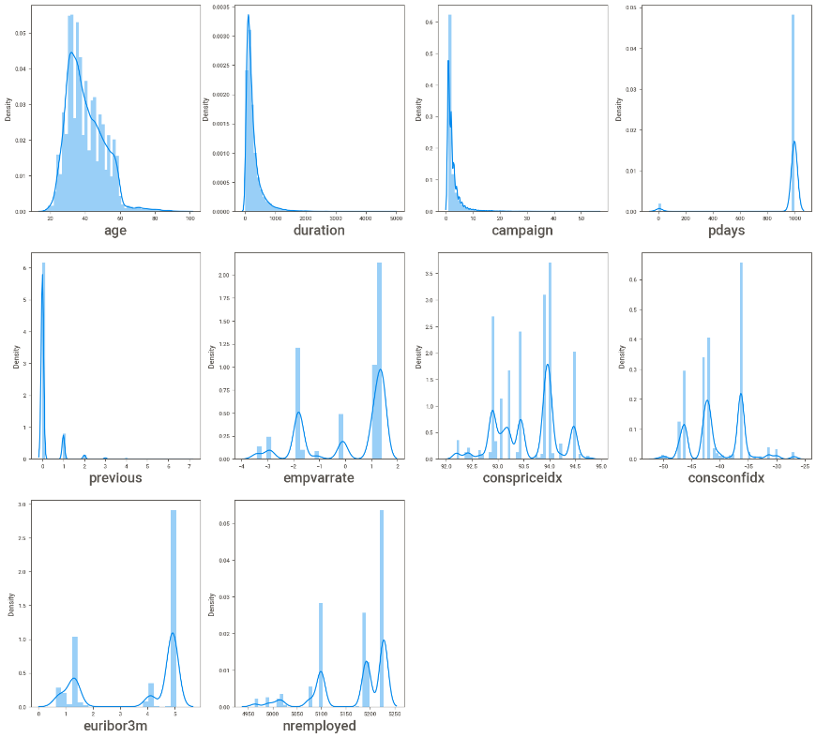
DATA EXPLORATION
This dataset contains 21 different features on 41188 observation. There have categorical and numerical features. Target variables was binary (‘Yes’or ‘No’)
Univariate Analysis of numerical features is shown here.

Slide 4
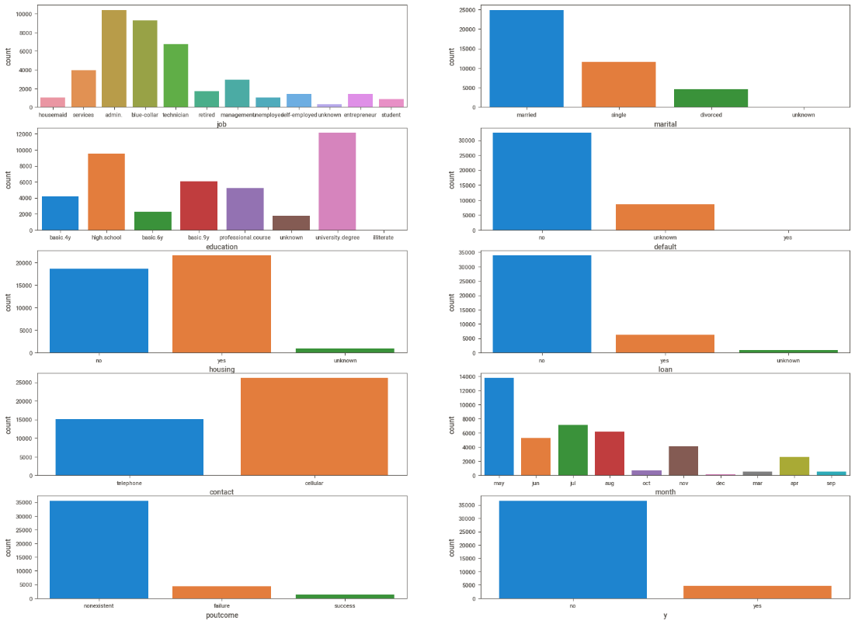
DATA EXPLORATION CONT...
Categorical variables were visualized by matplotlib and seaborn package to analyse the distribution.
There are several missing values in some categorical attributes, all coded with the "unknown" label. These missing values are treated as imputation techniques by replace with the label which has highest density.
In this data set we can see that most of the features having outliers more than 5%, so we need not to apply any outlier treatment here. If we go to treat these outliers we may loose information.

Slide 5
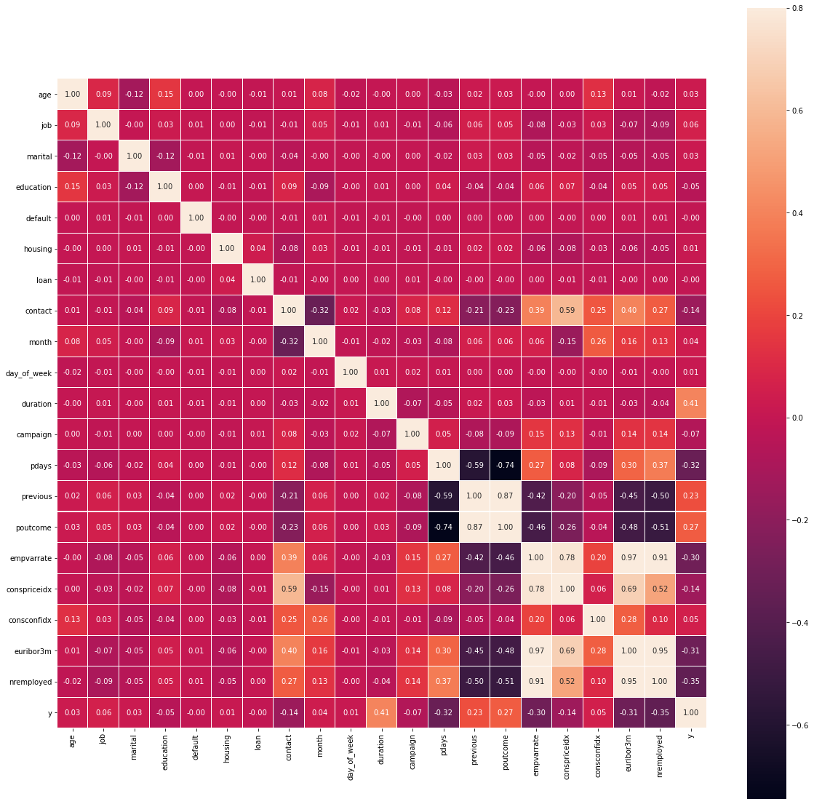
FeATURE SELECTION
There is highly correlative columns like. emp_var_rate, euribor3m are highly correlated to each other, so we will drop one of them. emp_var_rate, nr_employed are highly correlated to each other, so we will drop one of them. euribor3m, nr_employed are highly correlated to each other, so we will drop one of them.
Then we need to check if there are any duplicated rows exist or not. In this dataset there are 12 duplicated rows, we have drop those rows to increase model performances. We have checked if there was any constant features(Standard deviation is 0 of any feature to check) or unique features are there, if there are then we needed to drop them, in this dataset we do not have any type of them.

Slide 6
Model building
MODEL | PRECISION | RECALL | F1_SCORE
Logistic Regression | 0.86 | 0.86 | 0.86
KNN | 0.86 | 0.86 | 0.86
Bagging Classifier | 0.94 | 0.93 | 0.93
Random Forest Classifier | 0.95 | 0.95 | 0.95
Naïve Bayes | 0.74 | 0.73 | 0.73
GB & XGB | 0.95 | 0.95 | 0.95
SVM | 0.90 | 0.90 | 0.90
The Portuguese Bank marketing problem involves a classification challenge that whether a customer will subscribe to a fixed deposit scheme in response to a telemarketing campaign. It is a binary classification problem with YES or NO.
The classification models used here are the following.
1)Logistic Regression 2)KNN 3)Bagging Classifier 4)Random Forest Classifier 5)SVM 6)Decision Tree 7)Gradient Boosting 8)XGB

Slide 7
Result
The final model chosen is Random Forest Classifier as it shows the best performance of f1 score above 95%.
Hyper parameter tuning will be performed on this model.
However due to limited computation capabilities the hyper parameter tuning takes marginally higher times including hours and was unable to process it.

Slide 8
RECOMMENDATIONS
Collaborate with economic experts.
Be a fast mover, capture customers before competitors
Try to engage customers and have longer calls
Target relatively old age people. Convey peace of mind, safe investment, steady income source
Preferably use telephone as the mode of contact
Priorotize those customers who were part of the previous campaigns

Slide 9

QUESTIONS

Slide 10
OUR TEAM
MOHAMED SHAFEEQ VP
SONALI KUNDU
XIAO TONG
SUJWAL

Slide 11
THANK YOU

